Slide 1
WL3 Forum - Peer to peer coaching.
Thursday 19 January 2023

Slide 2
Objectives of today’s session.
Reflections from the last session
Introduce the concept of peer to peer coaching and the value it can bring
Share best practice and techniques
How to take it forward

Slide 3
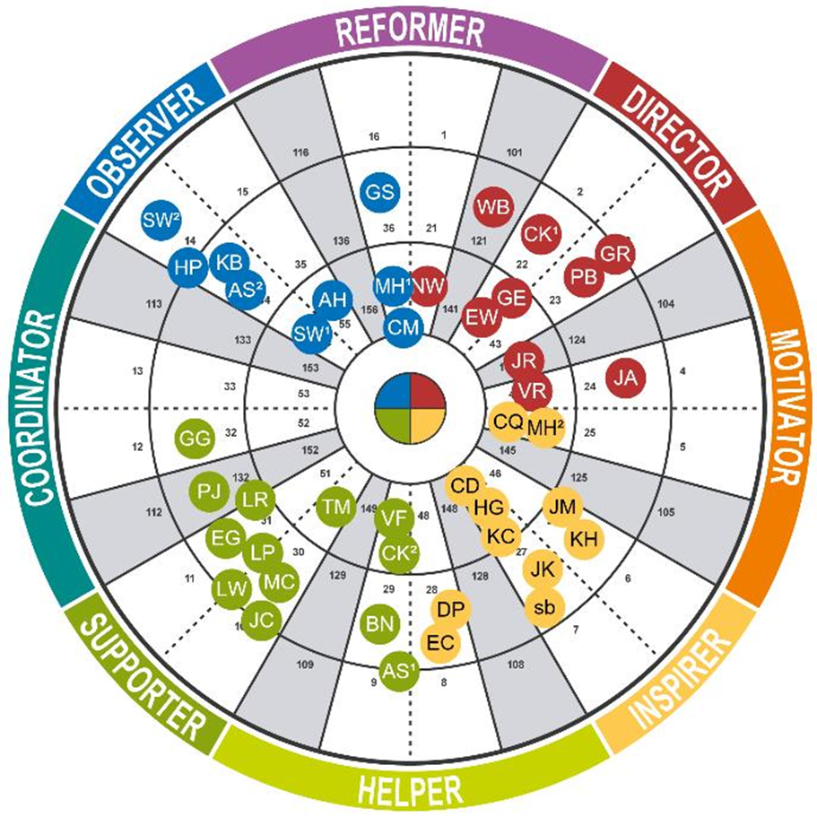
Recap: Our WL3 Insights Wheel.

Slide 4




Why peer to peer coaching?
Develop our coaching skills
Build a tighter WL3 community
Embed the culture of regular feedback conversations
A tool in the hierarchy challenge

Slide 5
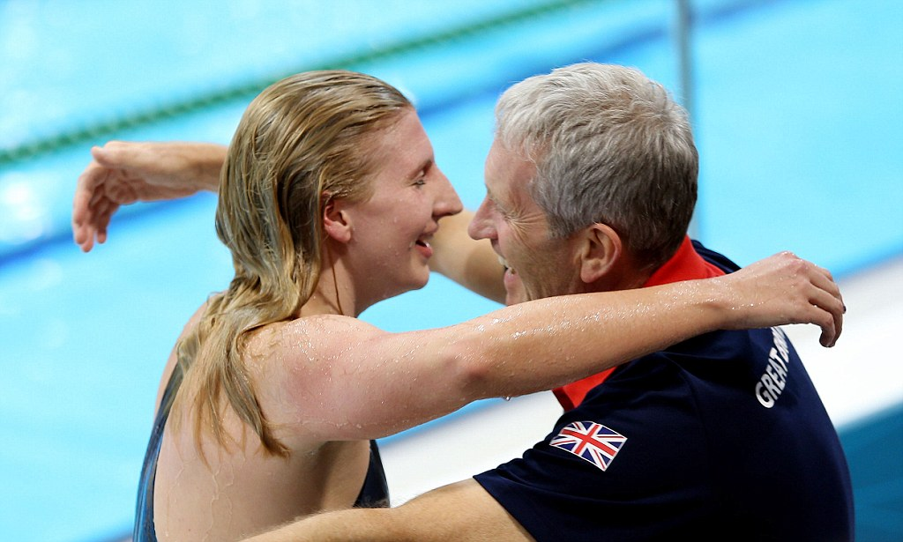
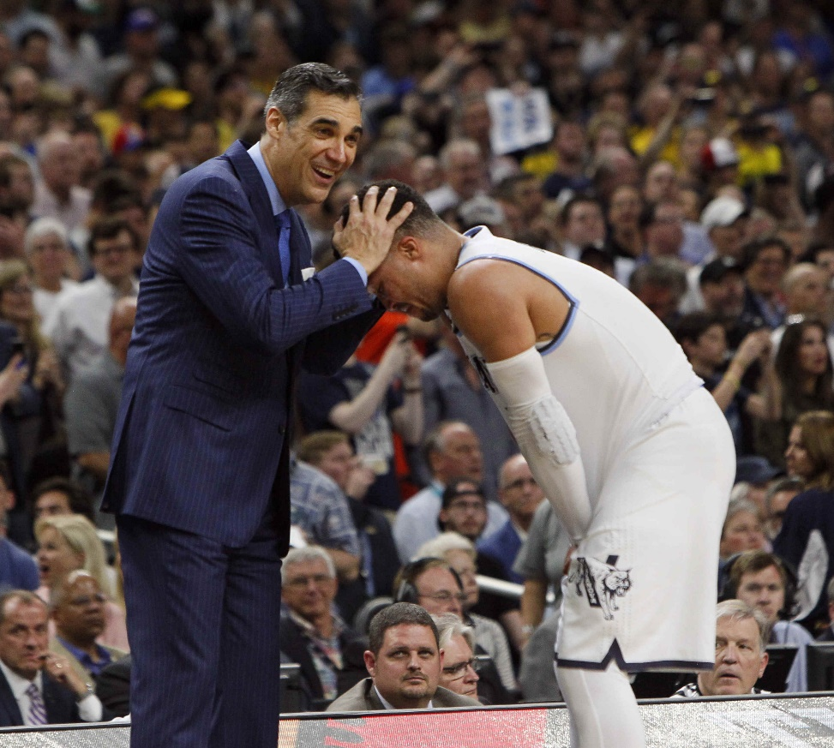

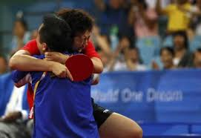
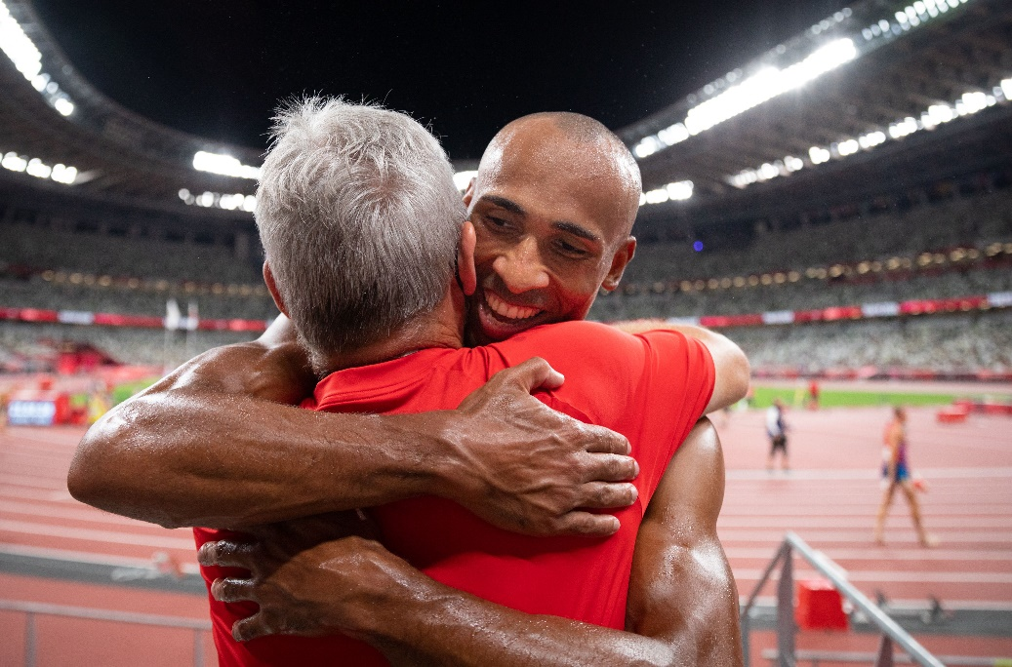
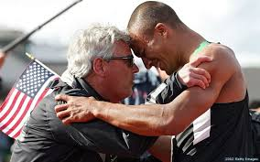
The case for coaching.
Notes:
The best athletes in the world have coaches – they bring a perspective the athletes don’t have.
Without coaches – athletes can’t get to the top of their game
A coach brings a perspective you don’t have
Coaches role is to guide, do some of the heavy lifting and you flex your style to the style of who you’re working with to help them fufil their potential
Simon Sinek quote

Slide 6

What is coaching?
Coaching is the art of facilitating another person’s learning, development and performance
Coaching raises self-awareness & identifies choices
Through coaching, people can find their solutions, develop their skills and change their attitudes & behaviours
The overall aim of coaching is to close the gap between people’s potential & their current state
Potential
Learning Zone
Performance
Comfort Zone
Notes:
Quote by Jenny Rogers

Slide 7
What is peer to peer coaching?
Peer coaching is a relationship between two or more colleagues, none of whom have oversight or authority over the others.
2
Within these dynamics, people share insights, feedback, challenges, and practices.
Peer coaching relationships provide accountability and are trust building.
Directive (Telling)
Non-Directive (Asking)
Telling someone what to do
Solving someone’s problems
Asking questions
Helping another solve their problems
Showing & experiencing
Offering guidance
Managing
Mentoring
Coaching
Notes:
Quote by Jenny Rogers

Slide 8
Benefits of peer to peer coaching.
To the Coachee
To the Coach
To the Organisation
More open & honest conversations addressing real challenges, creating trust
Empowers & encourages colleagues to take greater responsibility
Realisation of potential and improved performance
Develops active listening skills and asking questions to stretch & challenge thinking
Focused empathy centred interactions, creating space to practice leadership skills and flex style to help others grow
Better skilled to deploy coaching techniques up and down the organisation
.
Embeds coaching culture throughout the organisation, driving diversity of thought
Develops and maintains high performing teams
Utilises leadership as advisory role - managing volume of work going up the chain
Notes:
Your role is to deliver a different perspective, but in a way that makes sense for the individual

Slide 9

Peer to peer Coaching.
Guest Speakers
Peer to peer coaching.
Monthly Work Level 3 Forum
Speakers Clarasys
Notes:
Greeting:
Hello everyone, thank you for hosting us/me today, and thank you Jo and Jess for the introduction and overview of coaching
My name is Moray Busch, I am a consultant and coach at Clarasys, and very excited to be here.
The content, questions and interactions have not only be trialled in different client environments, but they have really been put to the test at home - some quite successfully. Some not so much, as it doesn’t compete with Jess’ professional negotiation training when she was a buyer, so I have surrendered myself to not winning any arguments at home.
Why coaching matters to us and what value it has unlocked

Slide 10
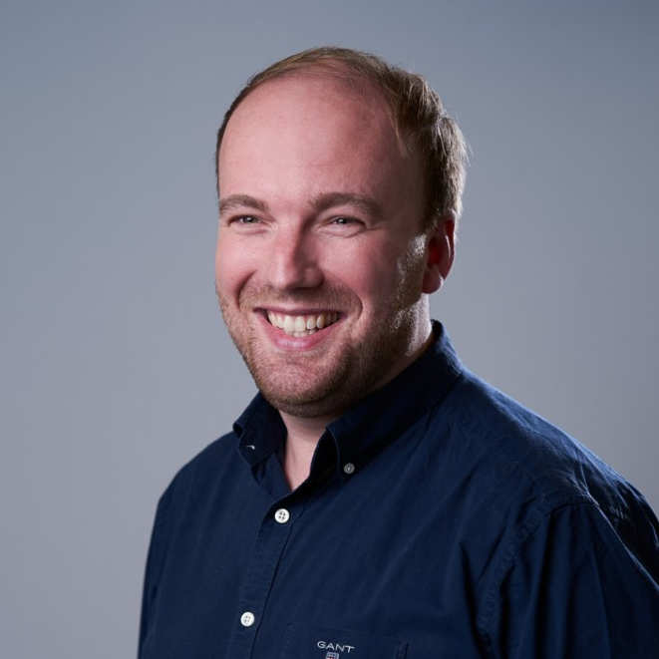



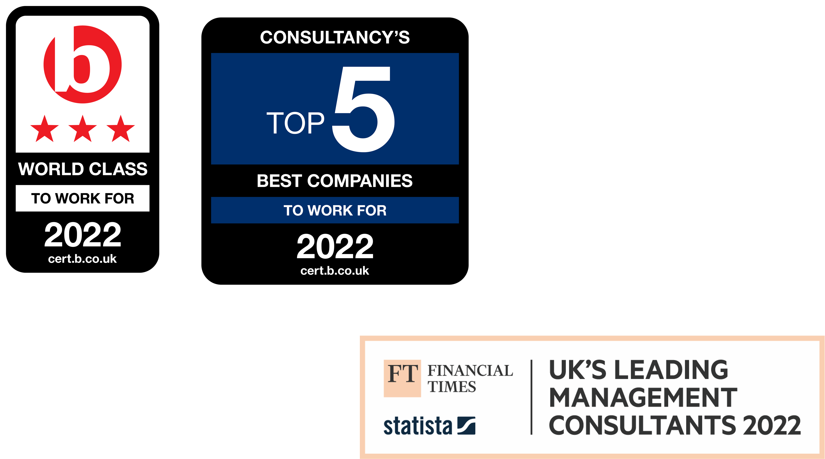
Intro to Clarasys and our speakers.
Ed Kemp Sloan
10+ years of consulting experience, working with Sainsbury’s, M&S, John Lewis, ASOS, Rentokil, Nuffield, Global Strategy House, Informa, RSPCA.
Coach for 7 years, coaching 5 internal employees and multiple client teams.
Moray Busch
8+ years of consulting experience working with Bank of America Merrill Lynch, Carnival, ARM, GSK, Informa, Vodafone and UK Gov.
Official coach to 6 internal employees, leading the Product capability internally & Programme and Product Lead.

Slide 11
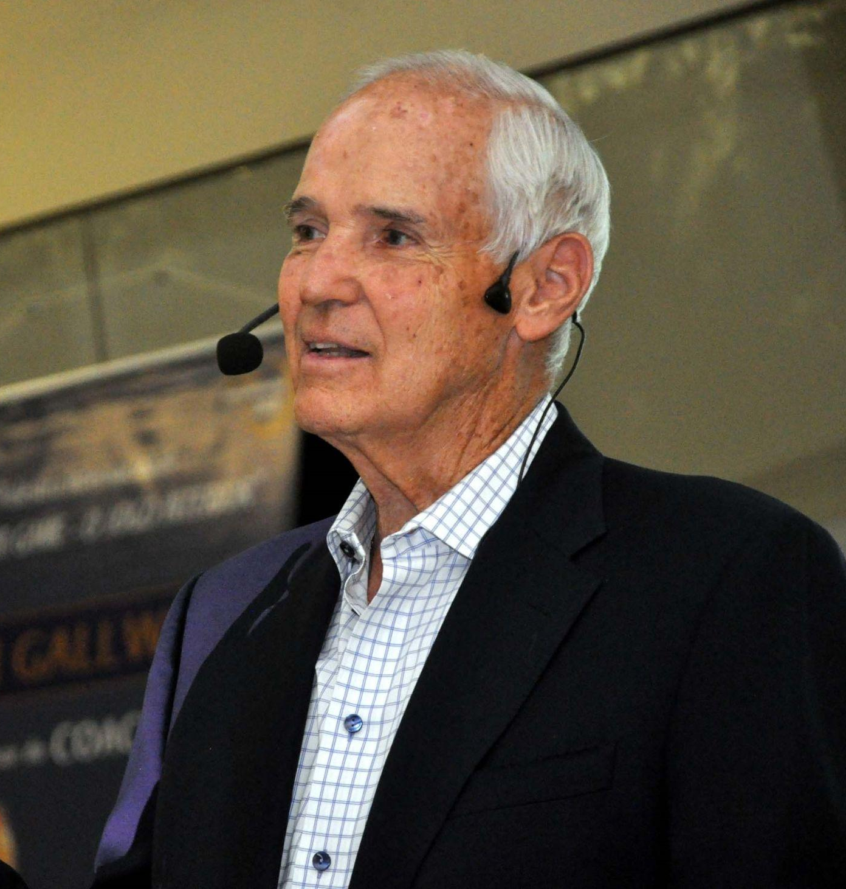
Coach, don’t tell.
You don’t need to be a subject matter expert (SME) in order to be an effective coach.
When Timothy Gallwey, who created the ‘Inner Game’ series on tennis, skiing and golf didn’t have enough tennis coaches, he dressed up two skiing coaches as tennis coaches.
What was surprising was that the skiing coaches out-performed the tennis coaches at coaching tennis!
Notes:
Referenced in multiple coaching books, this story highlights that by asking the right questions and focusing the mind, you can get further than telling people what and how to do something. He is also the person who came up with the formula of performance = potential - interference
Source story: https://www.ridethewave.co.uk/blog/what-is-coaching
Source image: https://dasein.com.br/inspire-se-com-tim-gallwey/

Slide 12
It is a journey.
And not the only solution.
How we got started
How you make it work
How you make it last
1
2
3
How Clarasys got started and what is our peer to peer coaching model?
The techniques you can use as a peer coach and be the adaptable leader you want to be
Getting the long term commitments, accountability and goals agreed to maintain the momentum

Slide 13
How we got started.

Slide 14
Peer coaching at Clarasys.
From director weekly 121s to peer to peer coaching.
Why we did it
The benefits
The unexpected benefits
As a lean organisation, we didn’t have a large central team of people partners
We didn’t have lots of directors with time to coach our Principal Consultants
Our most experienced consultants support each other, who likely have faced similar situations
More collaboration between senior team members and stronger relationships
More autonomy in decision making closer to the decision itself
Ad-hoc peer coaching is now widespread across more junior team members
Enabled our people to grow in exec-coaching skills and “coach upwards”
Peer coaching is not a silver bullet to solve all challenges; it’s just one tool of many to create a supportive and learning oriented culture.

Slide 15




The Clarasys P2P coaching model.
Situational leadership
GROW
Double Diamond
Lower confidence & competence
COIN
Trust
Equation
PDCA
Higher confidence & competence
Turn up in the right way
Build the right environment + setup logistics
Credibility + Intimacy + Reliability
Self-Interest
Take time to build trust
Trust =
Listening Empathy Sharing Vulnerability Respect
Turn up key coaching values

Slide 16
How to make it work.

Slide 17
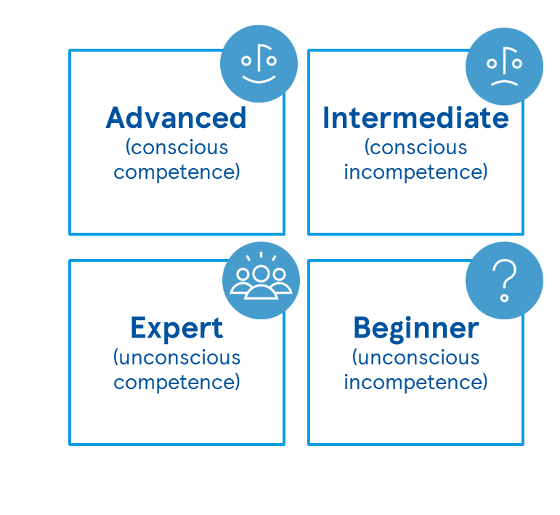
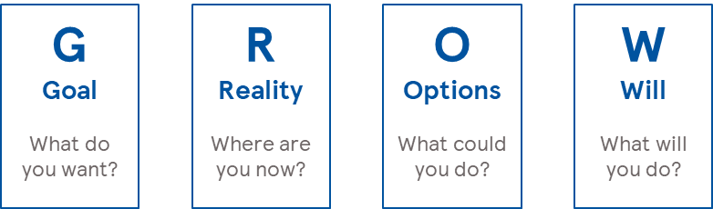

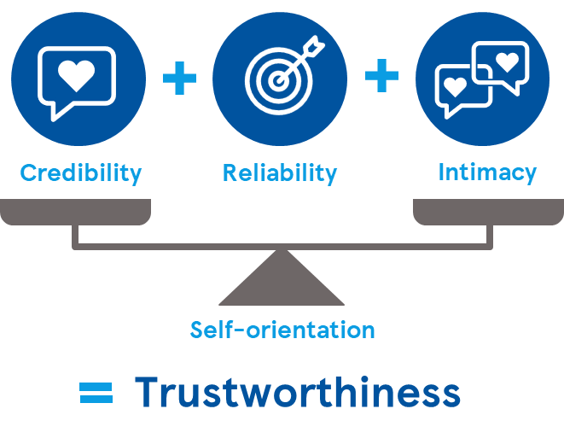
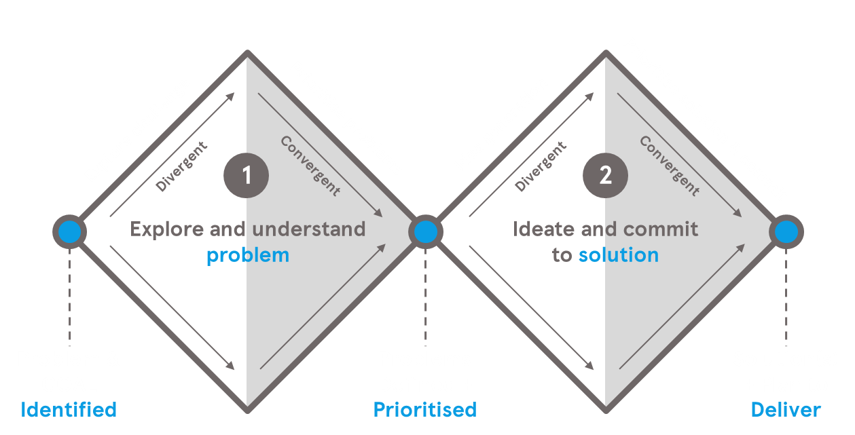
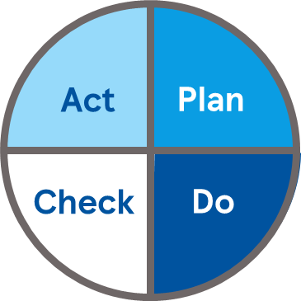
Coaching frameworks.
These are some of our favourites, today we will focus on the ones in blue.
Situational
Leadership
Giving feedback using COIN
The GROW Model
Define Context
Make Observation
Clarify Impact
Agree Next steps
The trust
equation
The double diamond
PDCA
Notes:
Image grow model: https://www.imperial.ac.uk/personal-tutors-guide/developing-students/coaching/the-grow-model/
Image trust equation: https://blog.jostle.me/blog/trust-equation
Image PCDA: https://www.lean.org/lexicon-terms/pdca/

Slide 18




First, learn what style is needed.
Depending on the need of the coachee, you might teach, coach, support or empower.
Time investment req.
Supporting
Advanced
(conscious competence)
Intermediate (conscious incompetence)
Coaching
Positive motivation and encourage for learning. Learner decides with leader
High in support, direction and time. Leader decides with learner.
Lack of commitment or confidence
Expert
(unconscious competence)
Beginner (unconscious incompetence)
Empowering
Teaching
Learners decides and informs leader.
High in direction and always some support. Leader decides
Incompetence
Notes:
What Should Leaders Do?
We know that leadership is about legacy and commitment, but, specifically to deliver
situationally, we discovered that leaders need to deliver and enable:
1. Support - this is the encouragement, motivating and coaching to grow commitment.
2. Direction - in this context, it is the telling or teaching a person in what needs to be done
to develop their skills and competence.
3. Decisions - across the continuum of making absolute decisions on one side and fully
empowering on the other
4. Ideas - big note on the word “facilitation”. The leader facilitates the formation, sharing
and adoption of ideas. A leader is not expected to know all the answers. They can’t.
That would not create collective brilliance and would put too much pressure on the
leader (potentially leading to an authoritarian style and would inhibit personal and team
development).
The Situational Leadership Model
There are a number of elements to the model that we need to understand:
1. The competence and commitment of the learner
2. The growth journey of the learner
3. The matched leadership style of the leader
4. The decision making matrix
We apply these to the 4 situations, recognising that, in reality, situation 3 is split into 2
distinct learner needs and so leader style - 3A & 3B
Situation One - The Beginner
Here, as we discussed, the learner is keen to start but does not know what to do
1. Learner Low competence, High commitment - keen but ...
2. Unconscious Incompetence “I don’t know what I don’t know”
3. Teaching leadership style - high in direction and always some support
4. Leader decides
Situation Two - The Intermediate
Here the learner now has some experience of the task, but has now become aware of how
little they know, and how big a journey and so their commitment drops
1. Learner Low competence, Low commitment
2. Conscious Incompetence “I know what I don’t know” - aware of the learning need
3. Coaching leadership style - both high in support and direction (and time)!
4. Leader decides, with the Learner
Situation Three A - The Advanced
Here the learner is now good at the task but is lacking the confidence to really give it a go -
“Go on, you can do it, give it a try”.
1. Learner Medium competence, Low confidence
2. Conscious Competence “I know what I know” - still needs conscious thought
3. Supporting leadership style - focus on positive motivation to act (and continue
learning)
4. Learner decides, with the Leader
Situation Three B - The Advanced
Here the learner is now good at the task but is over confident and considers themselves to
be experts - “Not so fast, let’s make sure we truly know first”.
1. Learner Medium competence, High confidence
2. Conscious Competence “I know what I know” - still needs conscious thought
3. Supporting leadership style - focus on encouraging further learning (
4. Learner decides, with the Leader
Situation Four - The Expert
Here the learner has established much experience of the task, and is both very capable
and committed.
1. Learner High competence, High commitment
2. Unconscious Competence “I don’t know what I know” - it is now in the subconscious
3. Empowering leadership style
4. Learner decides, and informs the Leader

Slide 19
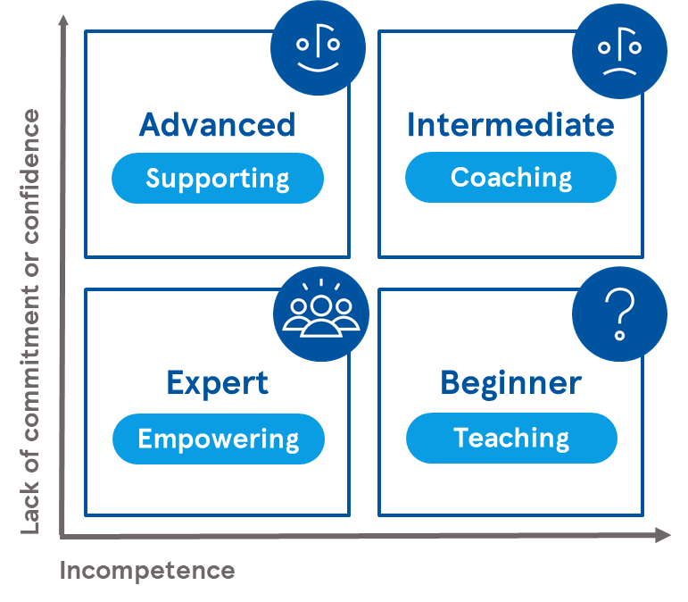
Adaptation in action.
Demonstration
Overview
The scenario – organise an event
Matching leadership styles
We require a volunteer to be a coachee.
The coachee will use the four activities of the scenario to the right and match each activity to one of the four levels of coach required. The coachee will explain what type of support they need (teach, coach, support empower) without explicitly saying it.
The coach (Moray) will have to understand what type of coach is required and respond accordingly.
The coachee has been tasked to organise a charitable fundraising event.
The high level activities include:
Building the proposition of the event
Organising the logistics of the room, food and drinks
Marketing the event and inviting the right people
Managing the event on the day
.
Notes:
We will do a live demonstration. First by hopefully correctly matching the type of support required and then doing it obviously wrong to show the impact as well.
Key message 1) dont micromanage expert 2) dont empower a beginner 3) singal what type you need as needed, normally start with more intent and then it becomes more natural

Slide 20
Coaching techniques.
We will use some of these in the next exercise, these are largely from the GROW model.
Set the goal:
What is on your mind?
What would you like to talk about?
What outcome are you looking for?
Enquire about reality:
What is happening now?
And what else (variants)?
What is the real issue for you right now?
What matters most?
Explore options:
What options are there?
What if…
What do you think?
What ideas do you have?
Call to action:
What needs to happen?
How might you achieve that?
What have you decided to do, and
by when?
What is the first step?
Throughout:
Mirror (repeat words)
Label (seems like….)
What > how & 5 why’s
Actively listen
Last impression is the lasting impression
Follow-up:
What worked well and why?
What did you learn?
What would you like to explore next?
What slowed you down?

Slide 21
The double diamond and GROW model.
Combining coaching techniques with two models.
Goal
Reality
Options
Will
Explore challenge
Prioritise problems
Idea generation
Prioritise solution & commit
1
2
Convergent
Convergent
Divergent
Divergent
Explore and understand
problem
Ideate and commit
to solution
Problem & GOAL
Identified
Problems Defined +
Prioritised
Solution(s)
+ Plan to Deliver
Notes:
Explain how GRO and double diamond can align. Explain how we use both of these models in consulting and UCD.
Ask volunteer to have a think what they would like to get out of the session. Do a mini live coaching session to go through GROW and the double diamond at the same time.
If it was awkward, imagine how much better it can be with someone you know and trust in private.

Slide 22


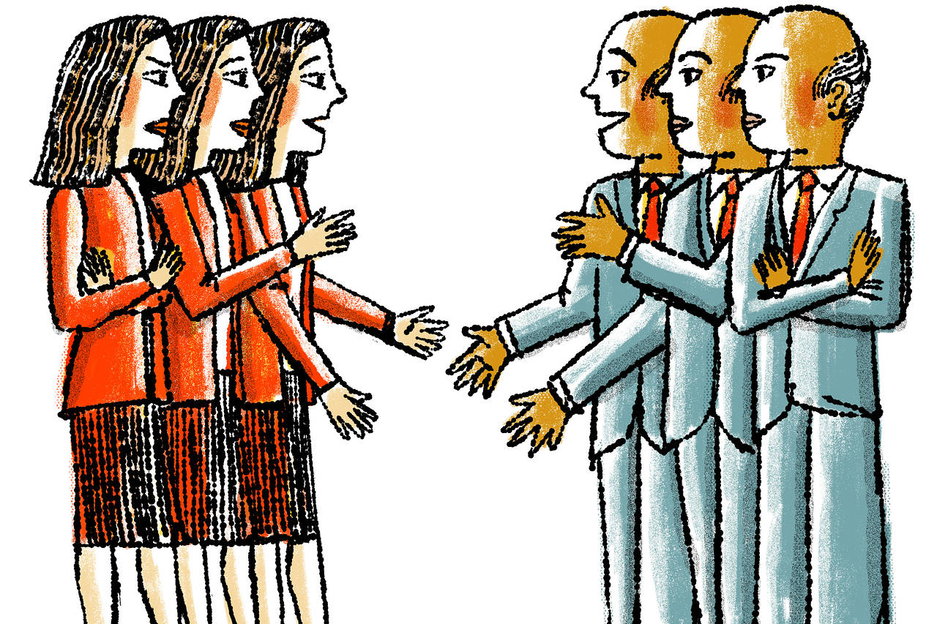
Putting it into practice.
In pairs, pick a simple topic and practice - then switch (2 minute each)
Mirror and label
Repeat last few words and summarise using ‘it seems like…’
Expand and focus
Start with ‘what’s on your mind’ and ask ‘what else’. Then focus on the ‘real issue’
Get commitment
If you like, ask what they are considering to do
Notes:
Image mirroring: https://s.wsj.net/public/resources/images/BN-PX301_WORKFA_M_20160920123603.jpg
Arrow image: https://interedgemarketing.com/wp-content/uploads/2019/05/so-many-choices.jpg
Commitment image: https://www.pegcalvario.com/wp-content/uploads/2019/07/commitment.jpg

Slide 23
How to make it last.

Slide 24






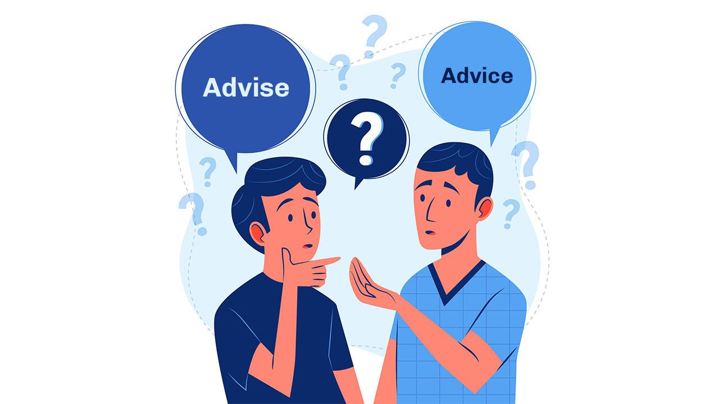

What enables and slows it down.
Enabled by your Winning Together Behaviours.
        Do put in a regular cadence
        Do meet face to face if you can
        Do create a environment for openness
        Don’t make it a status update
        Don’t give too much advice, unless needed
        Don’t be ‘just friends’, focus on the coaching relationship
Notes:
believe in each other, be Curious, be brave, live the 20/80

Slide 25




What you need to be successful.
Exercise to capture what you need from whom.
I need X
from Y to be successful
What do you need from a peer coach?
What do you need from your manager?
What do you need from the leadership team?
What do you you need from anyone else?
Notes:
Image peer coach: https://www.anncrafttrust.org/wp-content/uploads/2022/08/Peer-Support-Network.jpg
Image manager: https://images.businessnewsdaily.com/app/uploads/2019/11/20134742/communicate-goals-expectations-andffeedback.png
Image Leadership team: https://lsaglobal.com/wp-content/uploads/2019/06/effective-leadership-team-meeting.jpg
Image wider support: https://media.mktg.workday.com/is/image/workday/illustration-people-on-bar-charts-9?fmt=png-alpha&wid=1000

Slide 26
Finally, what commitment will you make today?
In your previous pairs, email each other one commitment with a due date

Slide 27
What’s next.
We hope that’s recharged you!
Reflect what you can take from today into your day to day – remember your commitments!
Hungry for more?
Please complete our feedback form post the session & share what you’re interested in learning more about
    Refer to the cards Moray & Ed have handed out – more information to follow!
In the form, let us know if you’re interesting in becoming part of a coaching circle (optional) – more info to follow!
Jo
Gareth
Aj
Example coaching circle
CK
George

Slide 29
Your P2P coaching model - Example logistics
Director
Every 6 weeks - 60 mins
Every 6 weeks - 60 mins
WL3
Every week 30-60 mins
WL3
Every week 30-60 mins
WL3
Every week 30-60 mins
Every week 30-60 mins
Peer Coaching Sessions | Frequency
1-2-1 with peer coach | Weekly
1-2-1 with director | 6 weekly
Group peer coach check-in | 6 weekly
Group peer coach performance review | Quarterly
Team manager
Team manager
Every week 30-60 mins
Team leader
Team leader
Every week 30-60 mins
Team member
Team member

